Slide 1
Unit 5 A cherry， please

Slide 2

Have some…句型操练

Slide 3
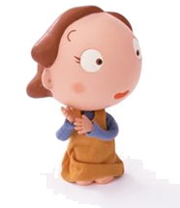
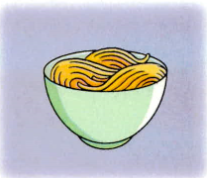

Have some noodles, please.
Thank you!

Slide 4
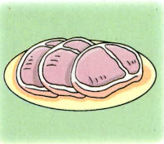
Have some meat, please.
Ok!

Slide 5
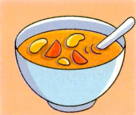
Have some soup, please.
Ok!

Slide 6
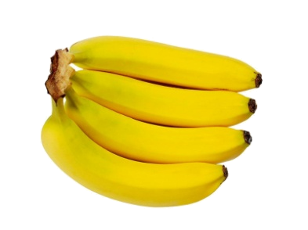
Have some bananas, please.
Ok!

Slide 7
Homework
1.请同学们把今天学的对话读熟。
2.请把今天学的新短语写在作业本
上，每个写两遍。

Slide 8


Thanks, bye!

